Slide 1
Chapter 15: Managing Marketing Channels and Wholesaling

Slide 2
Marketing Strategy Overview – Basic Structure
Analyze the environment and set the strategy
Company
(strengths & weaknesses)
Customers
Segment the market
Target your customers
Position your product
Competition
Product
Price
Promotion
Place
Leveraging real tools to implement strategic objectives

Slide 3
Preview
Marketing Channels
Intermediaries and Distribution

Slide 4
Marketing Channels
Consists of individuals and firms involved in the process of making a product or service available for use or consumption by consumers or industrial users.
Marketing channels make possible the flow of goods from
Producer → Intermediary → Buyer

Slide 5
What are Intermediaries
Intermediaries:
Middlemen, agent/broker, wholesaler, retailer, distributor, dealers
Intermediaries create value

Slide 6
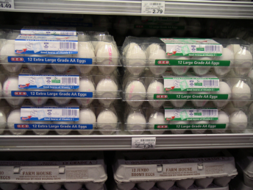
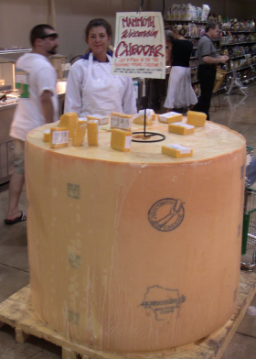
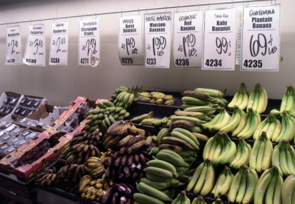
How Do Intermediaries Create Value?
Bulk-breaking
Sorting
Assorting
Notes:
Bulk Breaking - refers to one of the important functions of wholesalers which refers to the way wholesalers achieve savings for their customers through buying merchandize in large lots and breaking the bulk into smaller units.
Sorting - In sorting, intermediaries take a supply of different items and sort them into similar groupings,
Assorting - combining products into collections or assortments that buyers want available at one place.

Slide 7
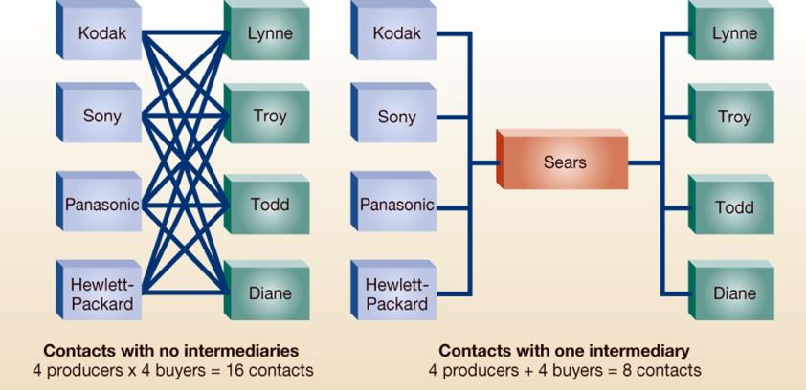
Why Else? Distribution Economies

Slide 8
We use intermediaries to…
Be more efficient: reduce the number of contacts
Allow firms to focus on core competencies
Reduce financial risk and investment

Slide 9
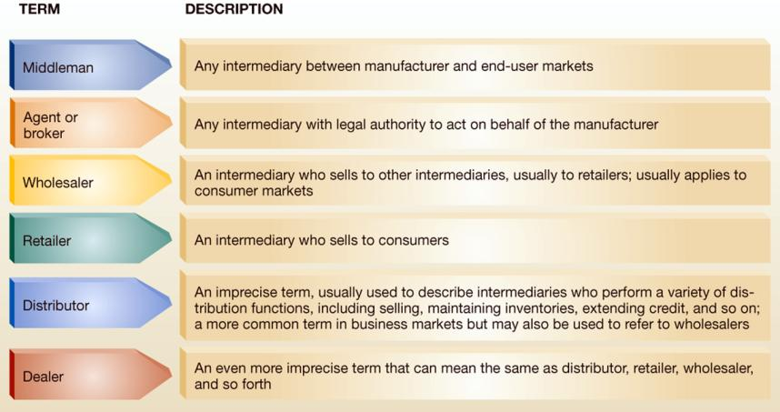
Who are the intermediaries?

Slide 10

Intermediaries - Transactional
Buying –
Purchasing products for resale
Selling –
Contacting consumers directly
Risk Taking –
Assuming risk for inventory that is unsold

Slide 11
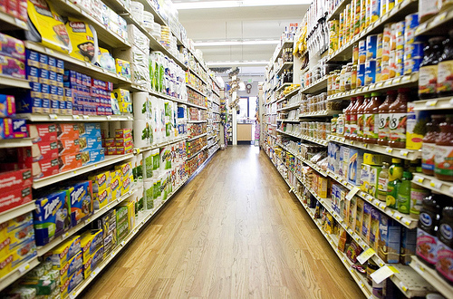
Intermediaries - Logistical
Assorting –
Bring products in from several sources
Storing –
Assembling products in convenient location for consumers
Sorting –
Purchase in large quantities and breaking it down for consumers into smaller quantities
Transport –
Moving product to customers

Slide 12
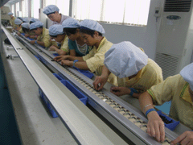

Intermediaries - Facilitating
Financing –
Extending Credit to consumers
Grading –
Inspecting or judging products
Marketing information and research–
Provide info to customers and suppliers about trends

Slide 13
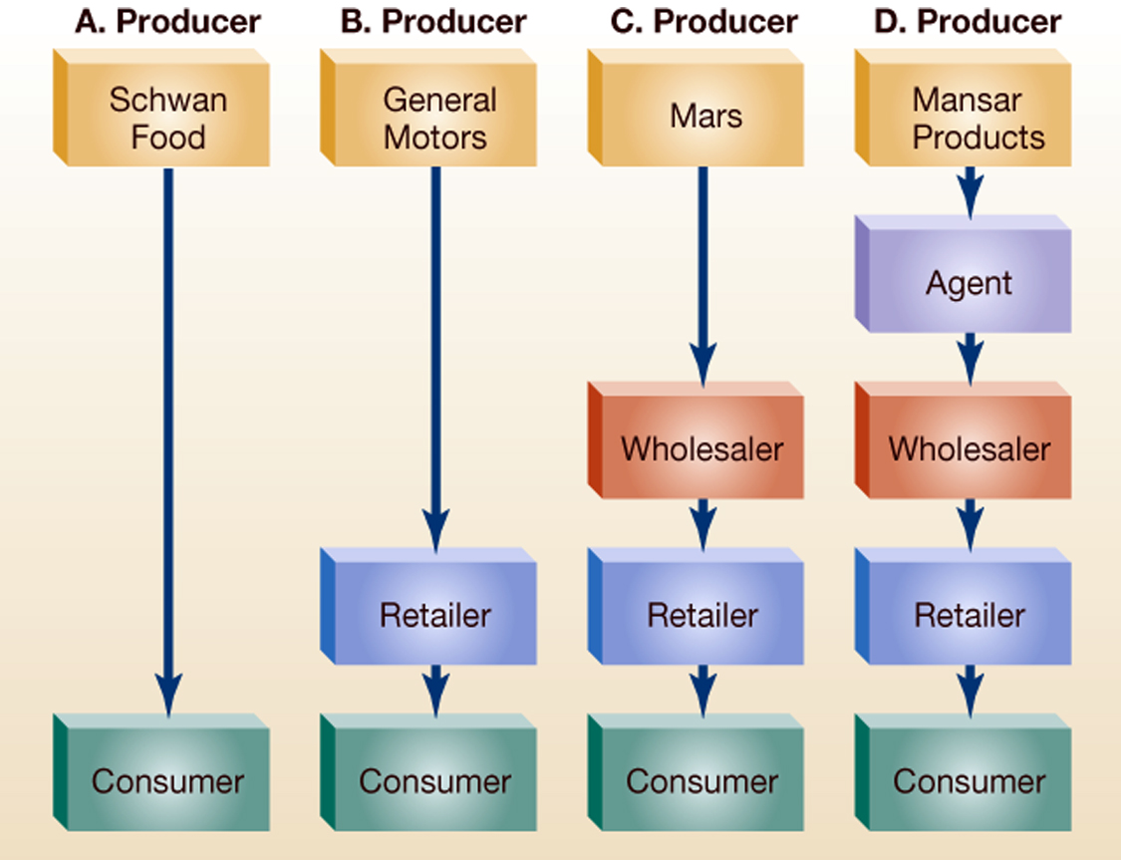
Marketing Channels for Consumer Goods and Services
Indirect Channels
Direct Channel

Slide 14

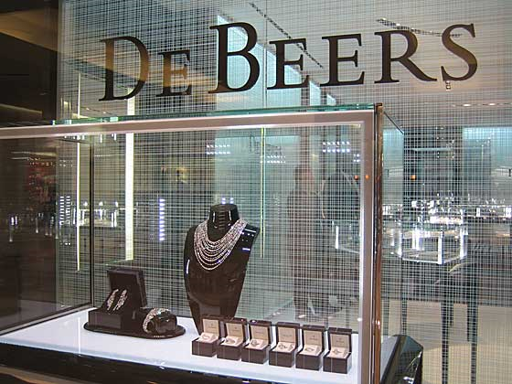
Trend toward Manufacturers going Direct to Retail…

Slide 15
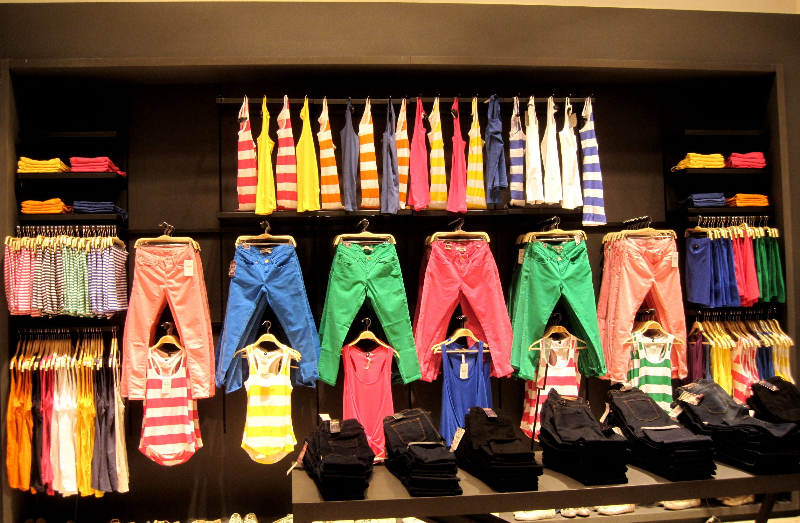
Zara

Slide 16
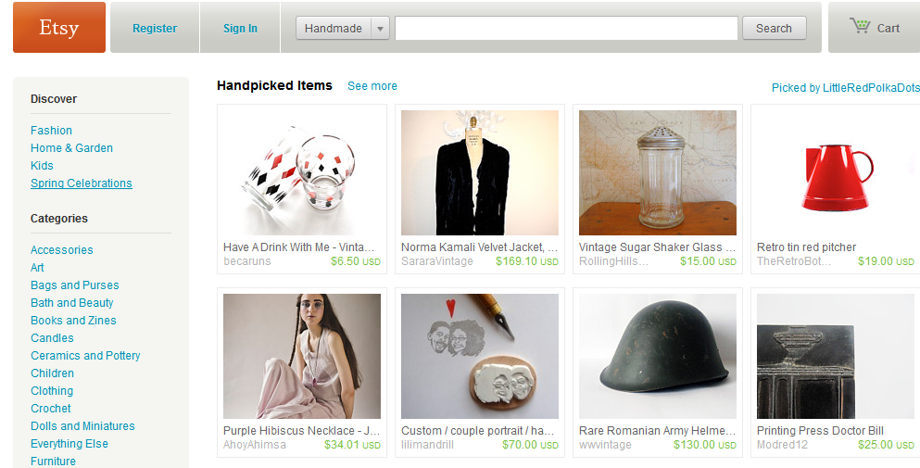

Slide 17
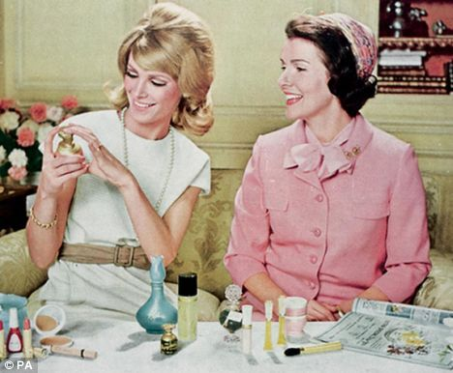
AVON has done this for years…

Slide 18
Marketing Channels for Consumer Goods and Services
Indirect Channels
Direct Channel

Slide 19
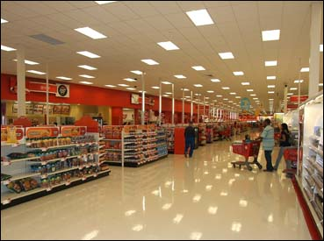
Indirect Channel - Target

Slide 20
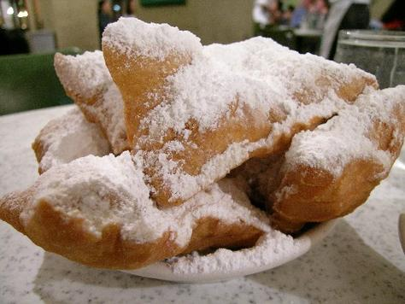
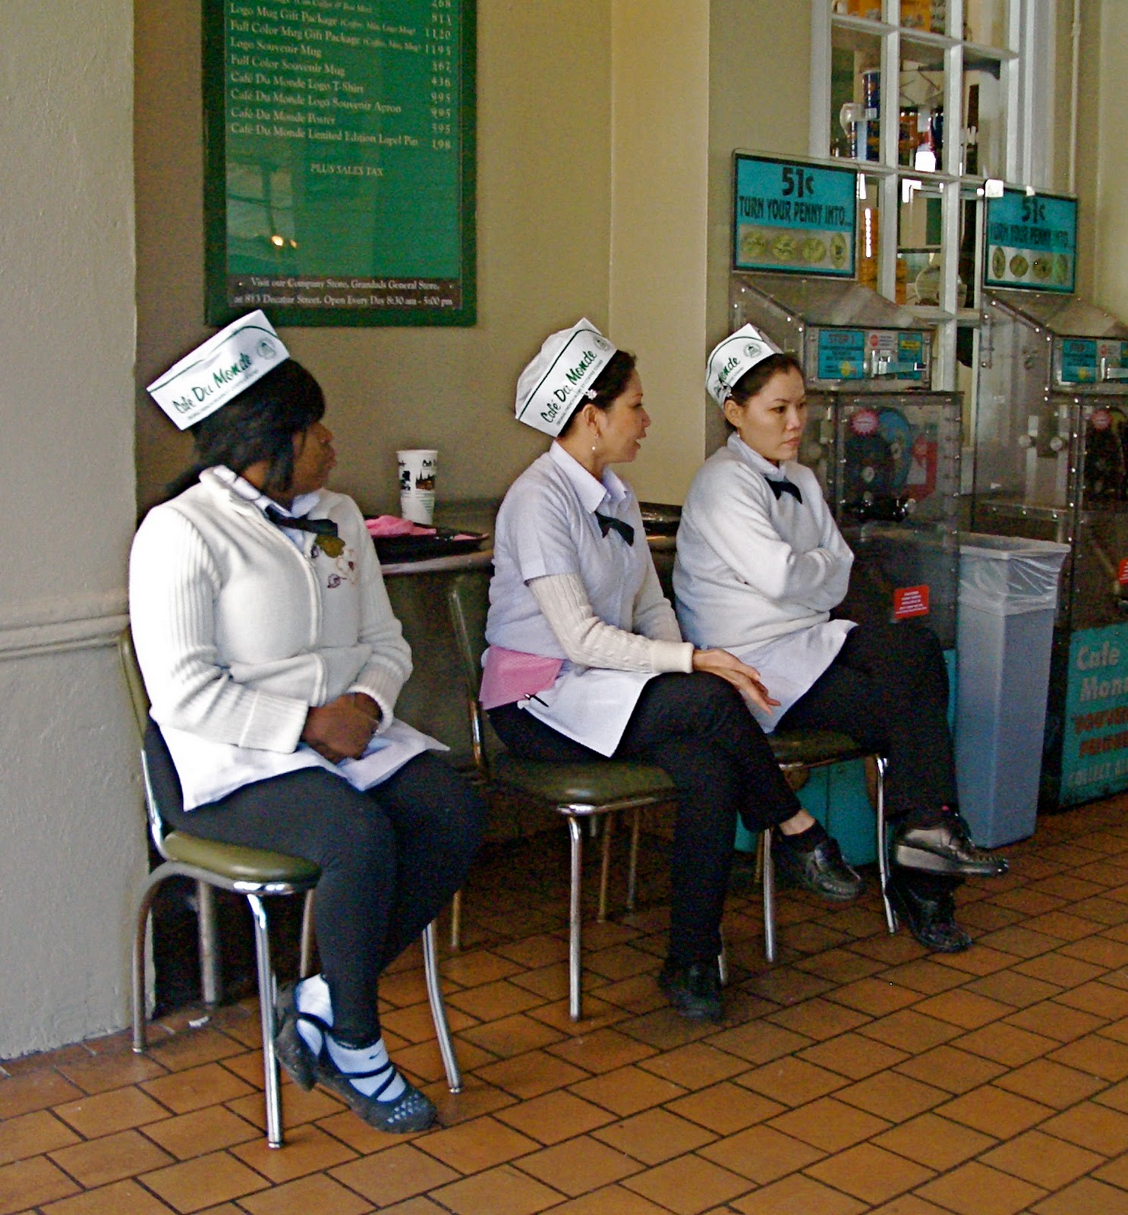
Café Du Monde
Staff purchases the beignets (middleman) to sell to the customer

Slide 21
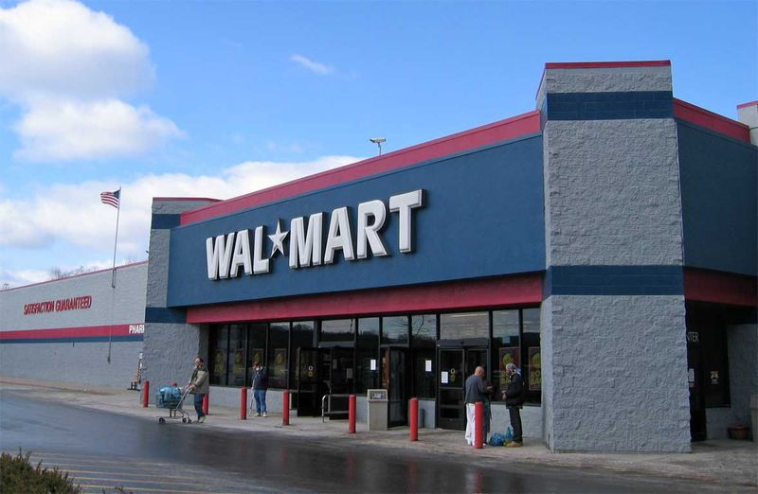
Wal-Mart
Based on the article, what does Wal-Mart do in their negotiations to benefit customers?

Slide 22
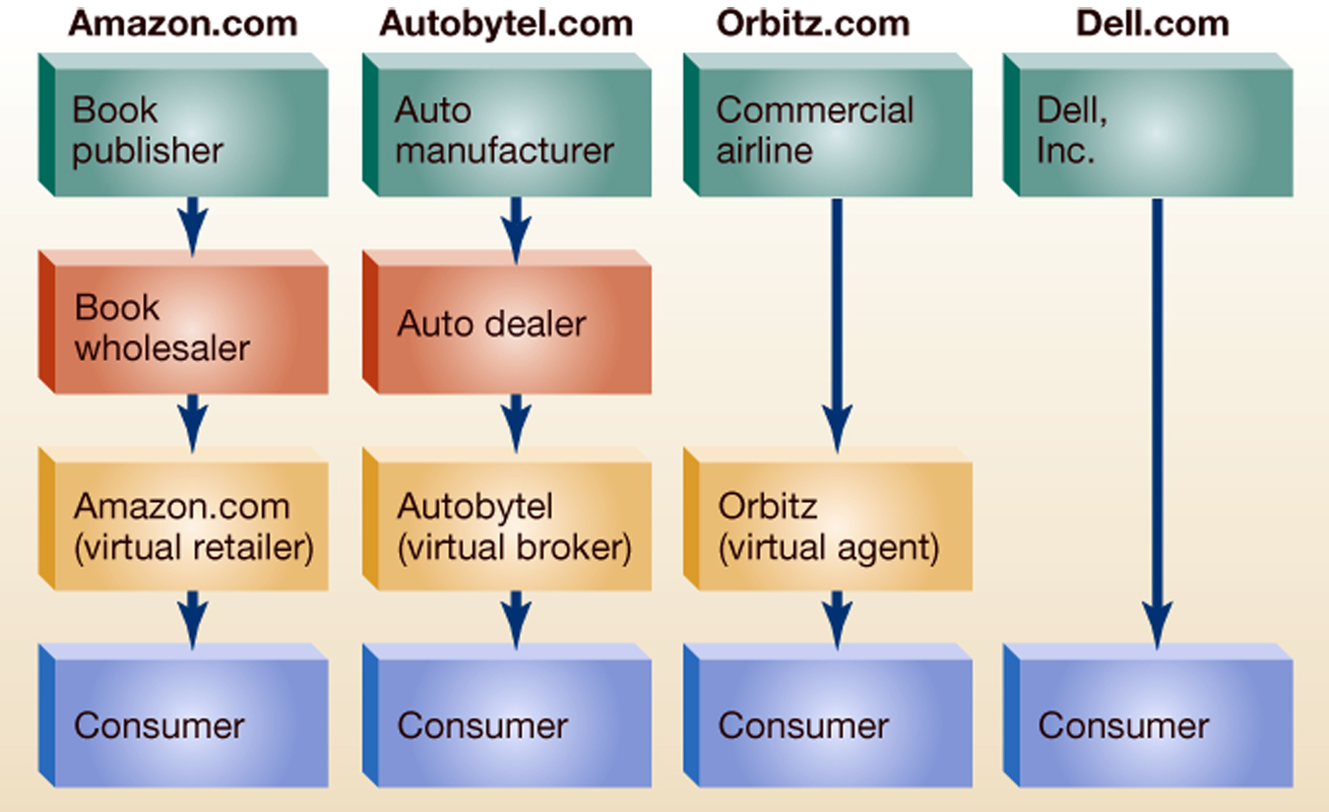
Electronic Marketing Channels

Slide 23
Electronic Marketing Channels
Amazon
Travelocity

Slide 24
How Do Firms Leverage Channels?

Slide 25



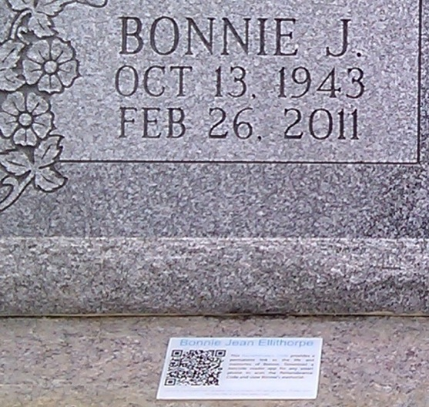
Direct Marketing Channels
Firms also use direct channels to market to consumers. Allow consumers to buy products by interacting with various advertising media without a face-to-face meeting with a salesperson.
QR Codes

Slide 26

Multichannel Marketing
Blending of different communication and delivery channels that are MUTUALLY reinforcing in attracting, retaining, and building relations with consumers
Catalog reinforces online

Slide 27
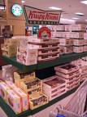
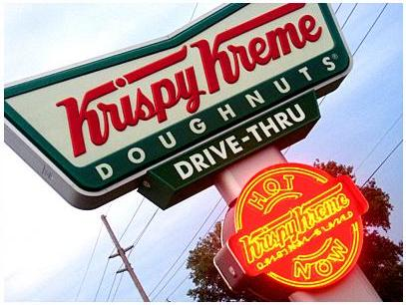
Multiple and Strategic Channels
Dual distribution: using two or more different types of channels to reach different buyers with the same basic product

Slide 28
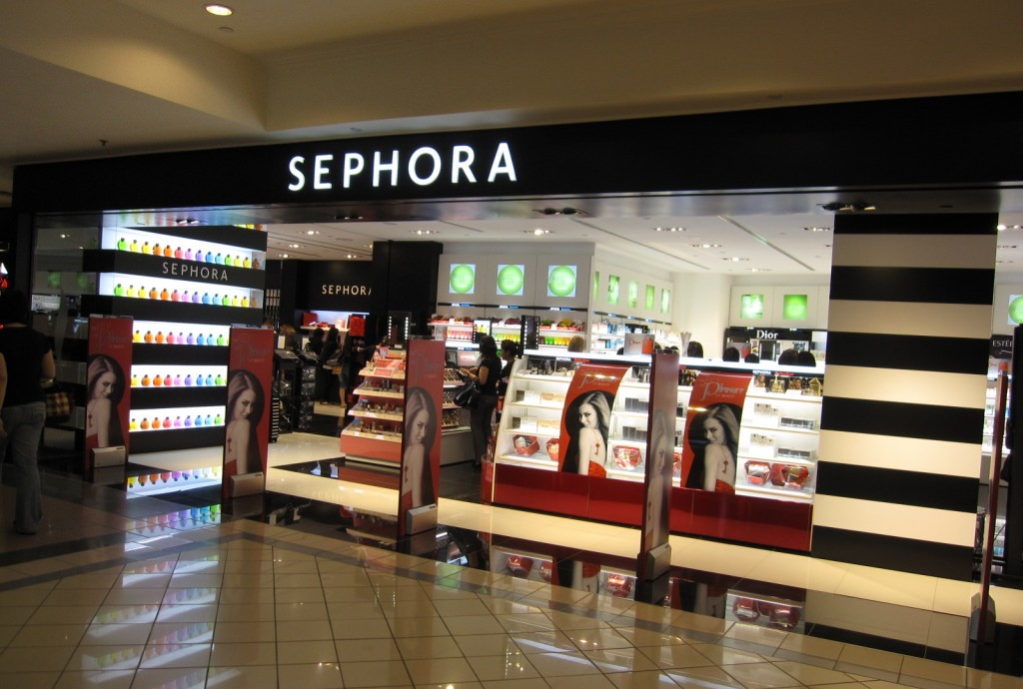
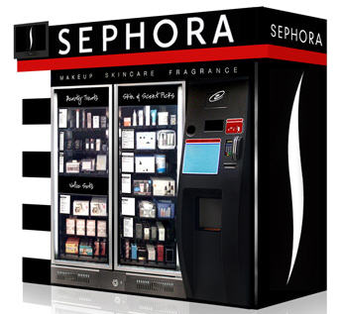
Dual Distribution
www.sephora.com

Slide 29
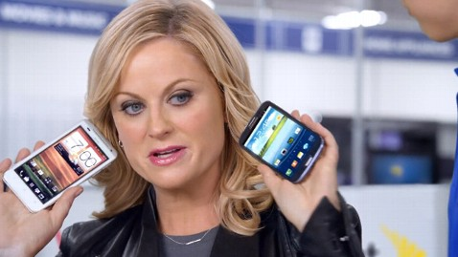
Strategic Channel Alliance
one firm’s marketing channel is used to sell another firm’s products
Best Buy 2013
Super Bowl

Slide 30
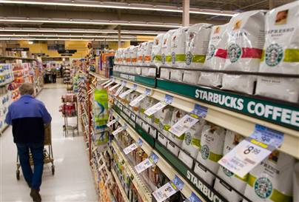
Direct Producer going Indirect

Slide 31
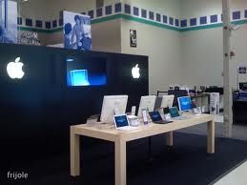
Apple at Best Buy

Slide 32
Channel Choice
Choice of market channel depends on:
Environmental factors
Social, economic, technological, competitive and regulatory
Consumer Factors
Where, when, how do they buy?
Where should we sell this?

Slide 33
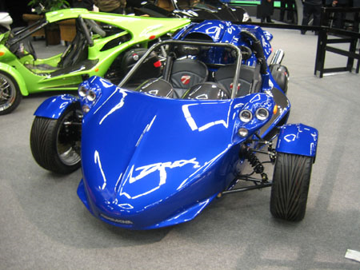
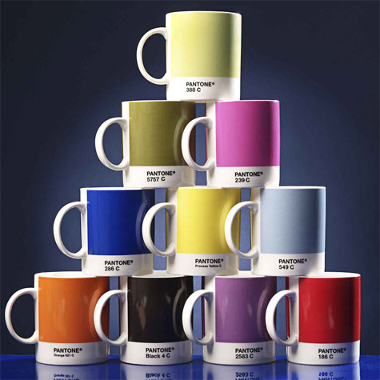

Channel Choice
Choice of market channel depends on:
Product factors
Sophistication of buyer based on product complexity
Direct or Indirect?

Slide 34
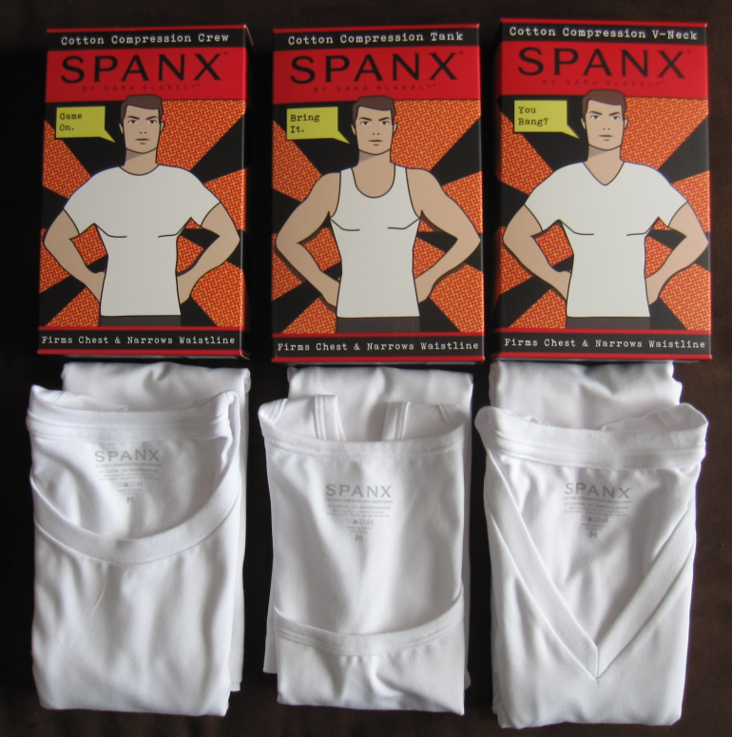



Channel Choice
Choice of market channel depends on:
Company Factors
Sales force available, match with product brand, target market of retailer

Slide 35
Channel Conflicts
Types of conflicts
Horizontal Conflicts occur among firms at the same level of the channel, e.g., Two car dealers.
Vertical Conflicts occur between different levels of the same channel, e.g., Ford and Firestone.
M
M
W
W
R
R
C
C
Question: What type of horizontal and/or vertical channel conflicts may occur in one of the following industries:
Personal computer industry,
Automobile industry,
Music industry,
Clothing industry.
Notes:
PC: HP selling computers direct from website (upset retailers)
Auto: Selling cars online through manufacturer. Chevy dealers competing against each on price. Note: Car doesn’t have overlapping regions. Only one dealer per region
Music industry: record companies selling directly to consumers, or bands to consumers via download
Clothing: Dooney and Burke selling at Costco and

Slide 36
Review
What is a marketing channel?
How do intermediaries create value?

